Slide 1


Competency -3 - Reading Skills
c. Identifying Tone, Themes & Ideas
Department of English
Session -2(Module 1)
Module 1:
Foundations of English for the Engineers : Accuracy, Clarity & Register

Slide 2
AIM OF THE SESSION
To help participants identify and correct the most frequent grammatical and structural errors influenced by Indian languages and technical writing habits, equip with specific self-editing techniques, to leverage AI tools for learning, not just correcting, and to analyze their own writing weaknesses and produce a clear, error-free written self-introduction.
INSTRUCTIONAL OBJECTIVES
Recall the rules governing articles, prepositions, and subject-verb agreement in standard English. Explain how direct translation from the mother tongue leads to common errors. Describe key self-editing techniques such as reading aloud, using checklists, and reverse reading. Construct prompts that require AI to explain grammar rules and error patterns. Revise the self-introduction using self-editing techniques and AI feedback.
LEARNING OUTCOMES
By the end of this session, learners will be able to: Identify frequent grammatical errors related to articles, prepositions, subject-verb agreement, run-ons, fragments, and dangling modifiers in their own writing. Apply at least three self-editing techniques to review a draft. Create prompts that make AI explain the reasoning behind corrections. Justify edits made to their self-introduction using grammar rules or AI explanations.

Slide 3
Session’s Point of interest…..
Common error patterns of Indian/engineering English: articles, prepositions, agreement, run-ons and fragments, dangling modifiers, and direct translation from the mother tongue.
Proofreading and self-editing fundamentals: a method for catching one's own errors.
Using AI as an accuracy tutor: how to ask an AI tool to explain (not just fix) an error, and how to learn from its corrections rather than copy them.
Personal Error Analysis & Self-Introduction (written)

Slide 4
Let’s fix the following
(Local to global)
Open the fan
I have one doubt .
Pass out from college.
Myself Anitha.
He is having two brothers.
Turn on the fan. / Switch on the fan.
I have a question. / I have a doubt about...
Graduate from college. / Completed college.
I’m Anitha. / My name is Anitha.
He has two brothers.

Slide 5
Watch the video
Please ensure that all key points are noted down.
https://www.youtube.com/watch?v=Ab4WIVqPpjM

Slide 6
Activity
Translation Triads
Write 5 examples under every column
Mother Tongue Direct English Translation Correct English
Nenu intiki velthunana I to home going I am going home
Naku thala noppiga undhi To me headache/pain is there I have a headache
Think in your mother tongue, truly translate……then learn the correct form.

Slide 7
Let’s try…
Translate Your Thoughts: first say the sentence in your mother tongue in your head, then write the English version exactly as it comes to you.
How would you tell a friend about your family?
I am having _*______*____
You didn’t go to class yesterday. How do you explain it to your teacher?
Yesterday I _*______*____
How do you ask someone if they know how to drive?
_*______*____ driving?
You want to say you’ve lived in Tadepalli for 5 years.
I am living in Tadepalli _*______*____
How do you give someone advice about health? You should take _*______*____

Slide 8
Run-ons and Fragments:
Run-on Sentence
A run-on sentence occurs when two or more sentences are joined incorrectly without proper punctuation or conjunctions.
Incorrect (Run-on):
I finished my homework I went to bed.
She loves reading she visits the library every week.
Correct:
I finished my homework, and I went to bed.
I finished my homework. I went to bed.
She loves reading, so she visits the library every week.

Slide 9
Run-ons and Fragments…..contd
Sentence Fragment
A sentence fragment is an incomplete sentence. It does not express a complete thought because it is missing a subject, a verb, or a complete idea.
Incorrect (Fragments):
Because I was tired.
Running through the park.
The boy who won the race.
Correct:
Because I was tired, I went to bed early.
I was running through the park.
The boy who won the race received a medal.

Slide 10
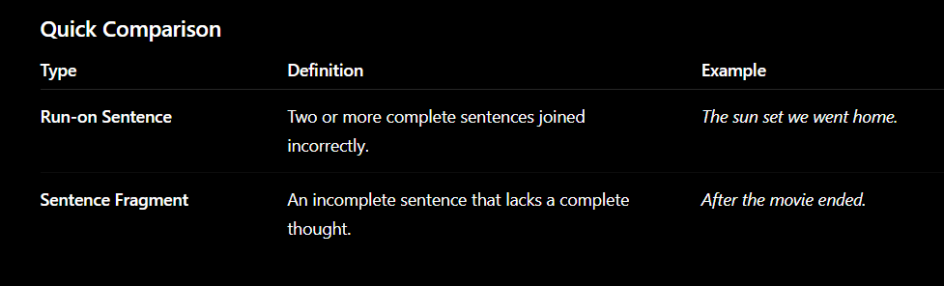
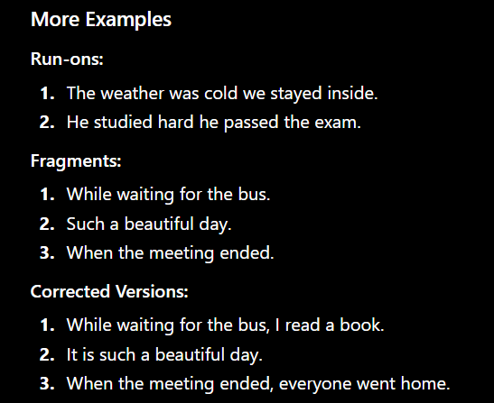

Slide 11
Dangling Modifiers
A dangling modifier is a word, phrase, or clause that does not clearly or logically modify the word it is intended to describe. The modifier is left "dangling" because the sentence is missing the appropriate subject.
Examples
❌ Dangling Modifier:
Walking to school, the rain started to fall.
(The sentence suggests that the rain was walking to school.)
✅ Corrected:
Walking to school, I noticed the rain starting to fall.
As I was walking to school, the rain started to fall.

Slide 12
Dangling modifiers….contd
❌ Dangling Modifier:
After reading the book, the movie seemed disappointing.
(The sentence suggests that the movie read the book.)
✅ Corrected:
After reading the book, I found the movie disappointing.
❌ Dangling Modifier:
Having finished the assignment, the television was turned on.
(The sentence suggests that the television finished the assignment.)
✅ Corrected:
Having finished the assignment, she turned on the television.

Slide 13
How to Identify a Dangling Modifier
Find the introductory phrase.
Ask: Who or what is performing the action in the phrase?
Check whether the subject immediately following the comma matches that performer.
Example:
❌ To improve his grades, the exams were studied carefully.
Who wants to improve the grades? Not the exams.
✅ To improve his grades, John studied the exams carefully.

Slide 14
https://yoodli.ai/?utm_source=chatgpt.com

Slide 15
Using AI as an accuracy tutor: how to ask an AI tool to explain (not just fix) an error, and how to learn from its corrections rather than copy them.
some effective prompts
1. Accuracy Tutor Prompt
"Act as my English accuracy tutor. When I write a sentence:
Correct only the mistakes.
Explain why each correction is needed.
Tell me which grammar rule applies.
Show one more example using the same rule.
Give me a short practice exercise.
Don't rewrite my whole sentence unless necessary."

Slide 16
2. Grammar Explanation Prompt
"Explain this sentence like I'm an English learner. Break it down word by word. Tell me why each word is used and what would happen if I changed it."
3. Mistake Analysis Prompt
"Instead of only correcting my English, analyze my mistakes. Tell me whether they are:
Grammar Vocabulary
Word order Tense
Articles Prepositions
Naturalness Then explain how to avoid making the same mistake."

Slide 17
4. Learn From Errors Prompt
"Every time I make a mistake, teach me the rule behind it. Don't assume I already know the grammar.“
You write:
He go to school yesterday.
AI response:
Correct sentence: He went to school yesterday.
Mistake type: Verb tense
Rule: When talking about a completed action in the past, use the past tense. The past tense of go is went.

Slide 18
More examples:
She ate breakfast early.
They watched a movie last night.
Practice:
I ___ (see) my friend yesterday.
We ___ (buy) a new phone last week.
This approach turns every mistake into a learning opportunity rather than just providing a correction.
If your goal is to become fluent, you can also ask the AI to follow a "Correct → Explain → Practice → Test" cycle after every message. This helps reinforce the rule immediately instead of simply fixing the sentence.

Slide 19
Portfolio Activity 1
Project Use-Case: Self-Introduction and Error Analysis
Refer the Portfolio Activity format for instructions.

Slide 20
SELF-ASSESSMENT QUESTIONS
Reflection Questions
How can AI help you improve your English beyond simply correcting mistakes?
What characteristics make an effective AI prompt for learning English?
Why is it important to ask AI to explain corrections instead of only providing the correct answer?
How can you verify whether an AI-generated correction is accurate?
What are the advantages and limitations of using AI as an English tutor?
Application Questions
Write one prompt you would use to improve your English writing.
How would you modify your prompt to receive more detailed feedback?
Which English skill (grammar, vocabulary, writing, speaking, or pronunciation) would you use AI for, and why?
Give an example of a sentence and explain how you would ask AI to help you improve it.
Design a prompt that encourages AI to teach rather than simply provide answers.

Slide 21
Critical Thinking Questions
Should learners always accept AI corrections without questioning them? Why or why not?
What ethical and academic considerations should students keep in mind when using AI for language learning?
How can AI promote independent learning instead of creating dependency?
In what situations might a human teacher's feedback be more valuable than AI feedback?
How does the quality of your prompt influence the quality of the AI's response?
Exit Ticket (1-Minute Activity)
Ask students to respond to these three questions before leaving:
One thing I learned today is...
One prompt I will use in the future is...
One question I still have about using AI for English learning is...

Slide 22
THANK YOU
Team – Language Skills for Engineers
Enjoy Learning-Make Every Day a Learning Day

